Slide 1
604-FINAL PROJECT
TEAM-10
SIDDHIDHATRI ROHITH REDDYJ
DEVA KISORE REDDY S
JATHIN REDDY T

Slide 2

DATASET GOOGLE PLAYSTORE
The Dataset consists of Google Playstore apps and app details like size, genres, content rating, no.of downloads, review_count etc.,

Slide 3
INTRODUCTION
Aim is to predict
Top 10 App Downloads
Bottom 10 App Downloads
Top 10 App Genres
App Rating Distribution
Top 10 App Reviews
Content Rating Distribution

Slide 4
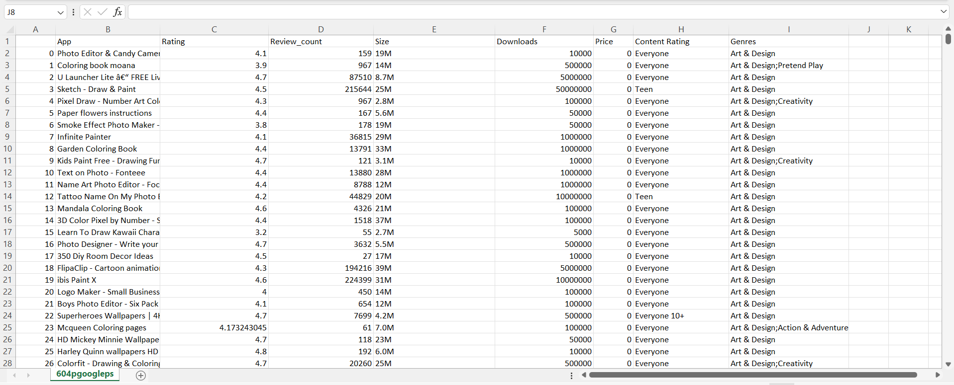
DATASET

Slide 5
TECHNOLOGIES USED:
AWS S3 Buckets
AWS Glue
AWS Glue Databrew
Redshift
Tableau

Slide 6
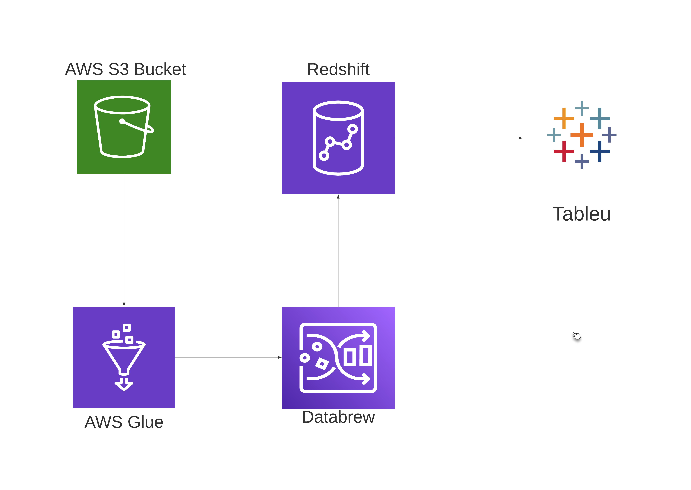
WORKFLOW

Slide 7
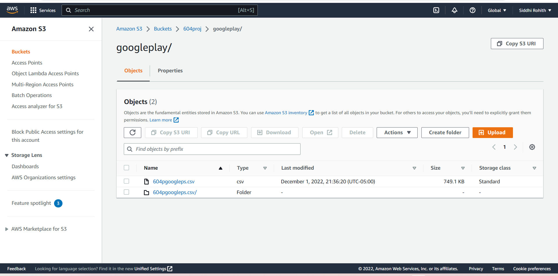
WORKFLOW

Slide 8
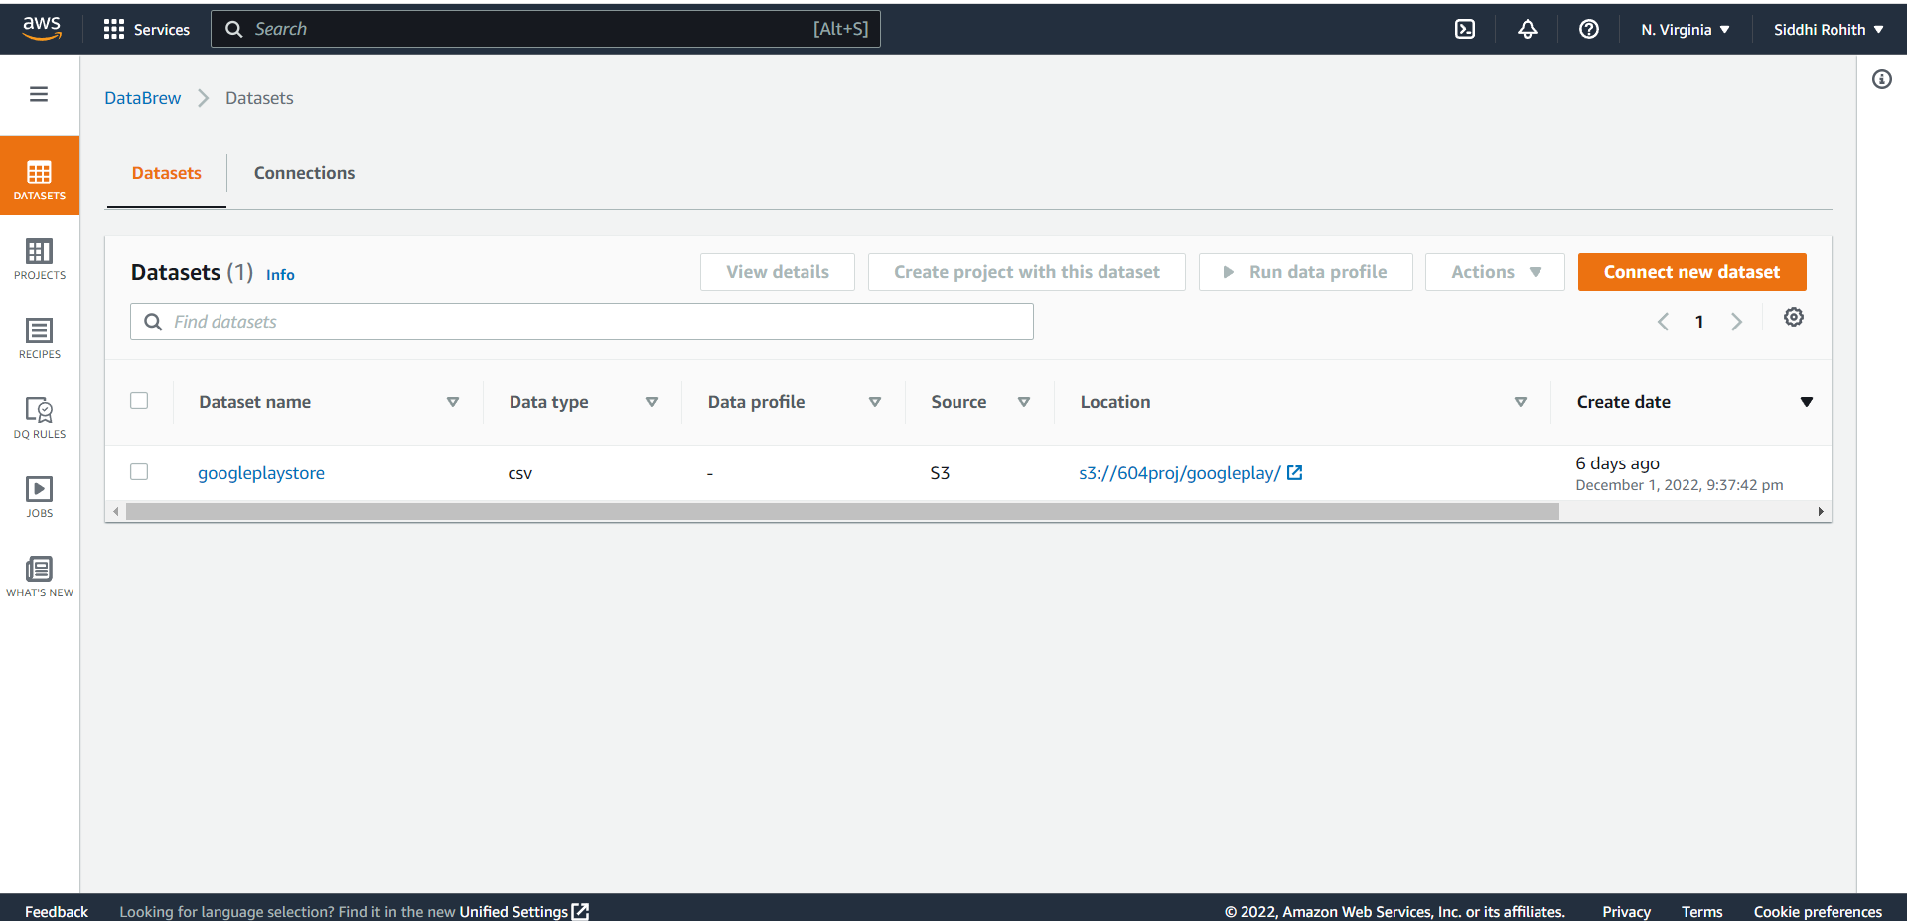
WORKFLOW

Slide 9
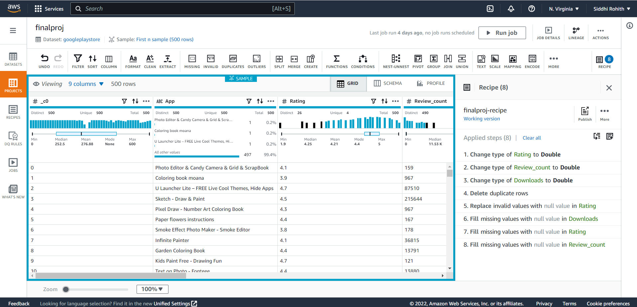
WORKFLOW

Slide 10
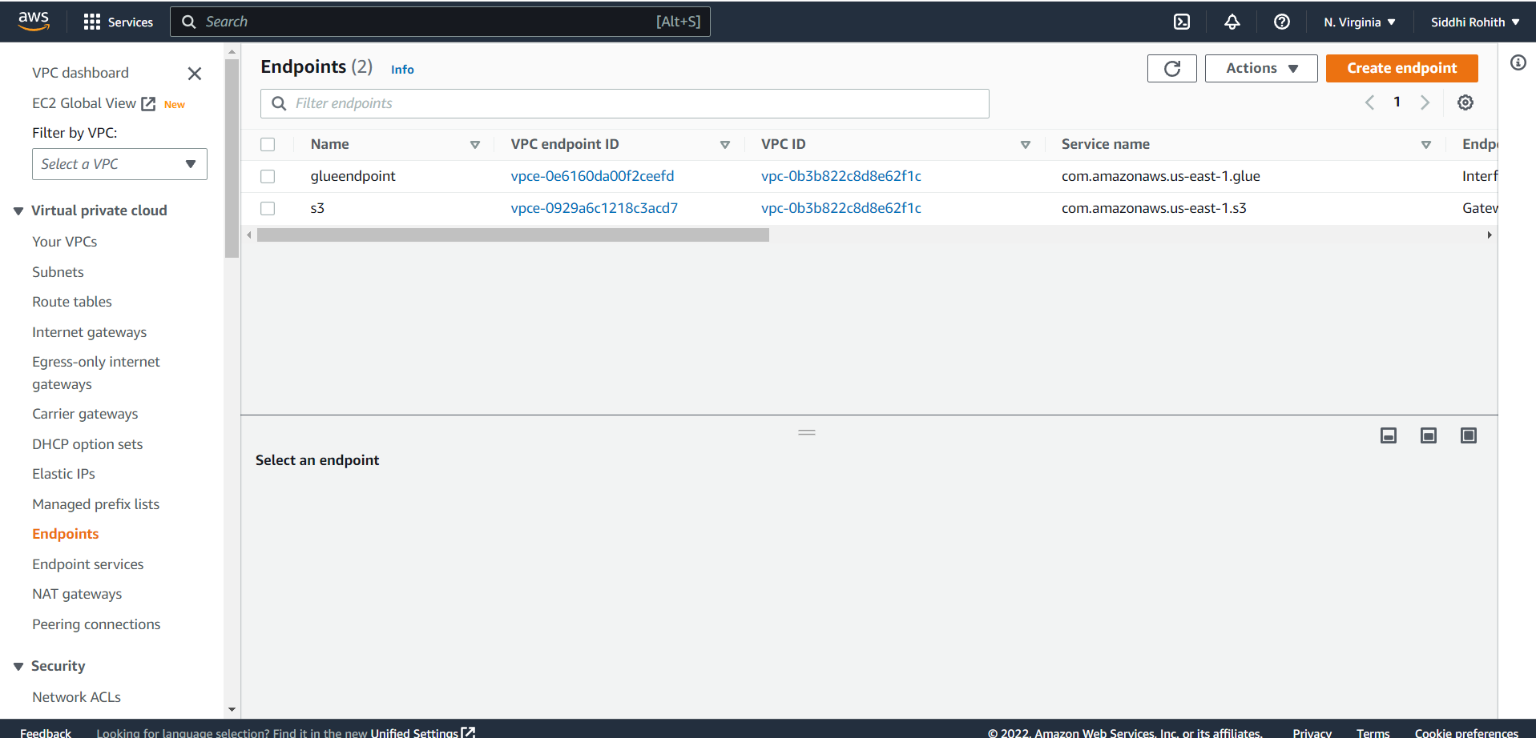
WORKFLOW

Slide 11
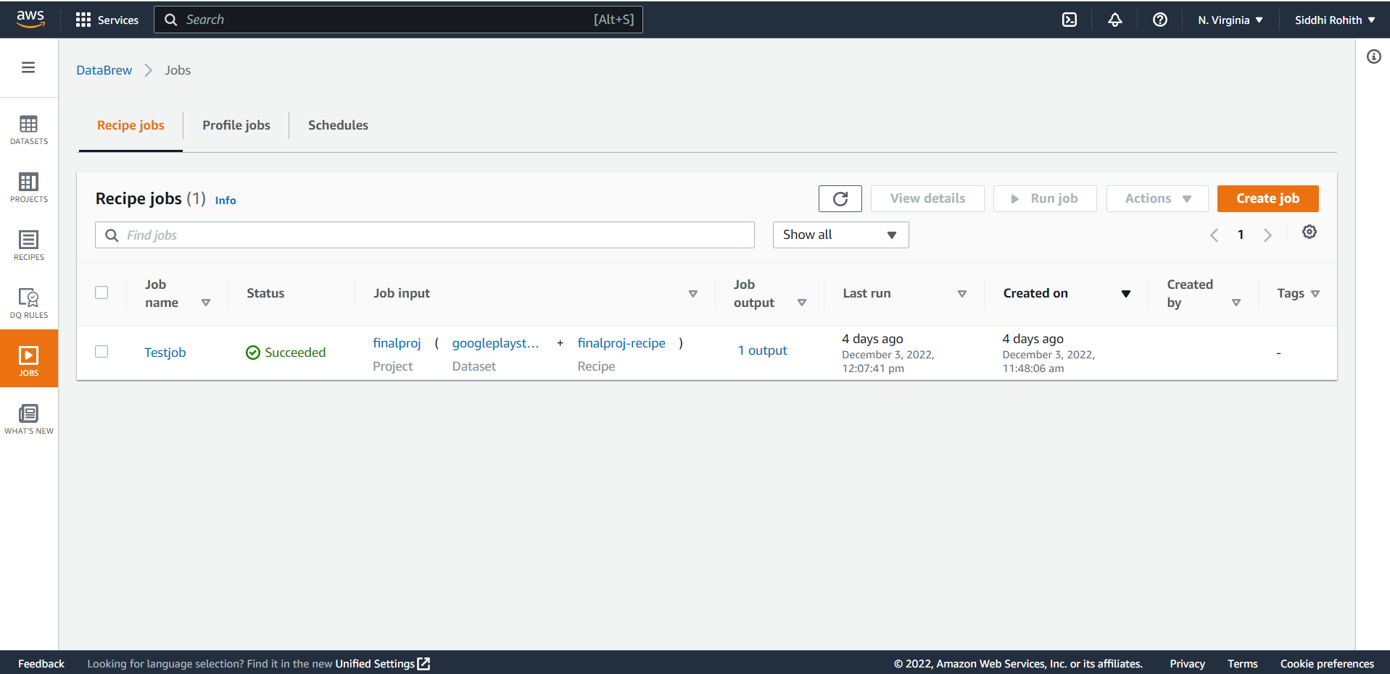
WORKFLOW

Slide 12
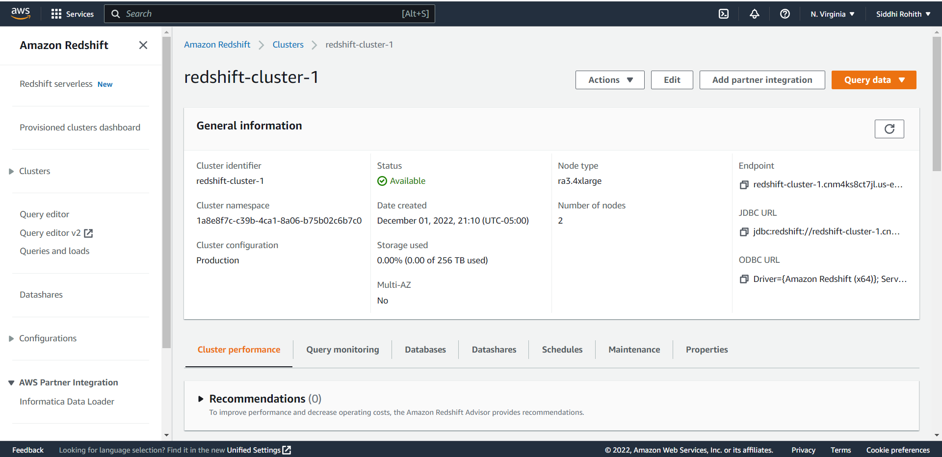
WORKFLOW

Slide 13
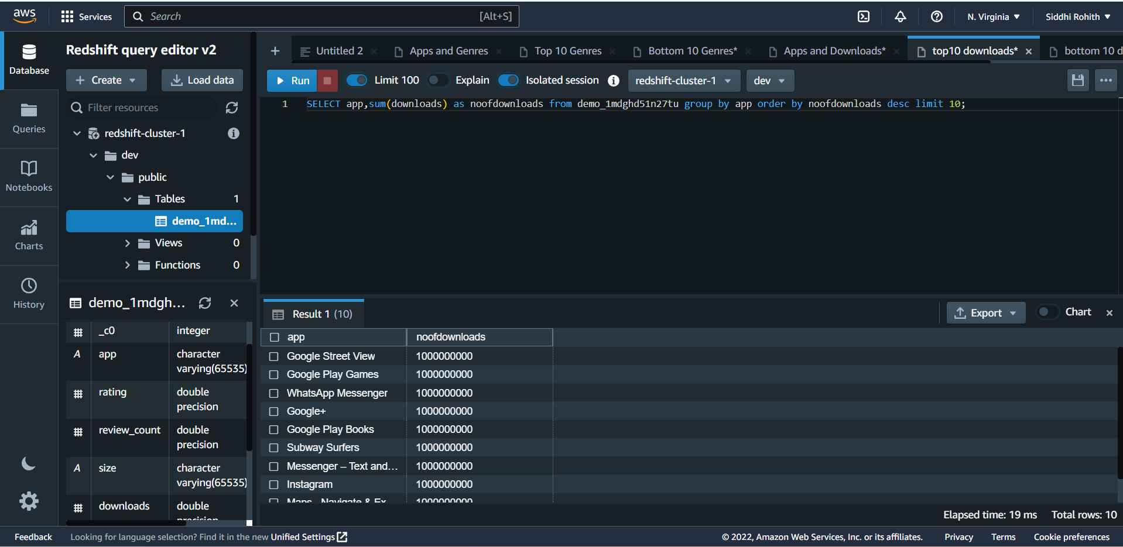
QUERY ANALYSIS:
CASE STUDY 1: TOP10 DOWNLOADED APPS

Slide 14
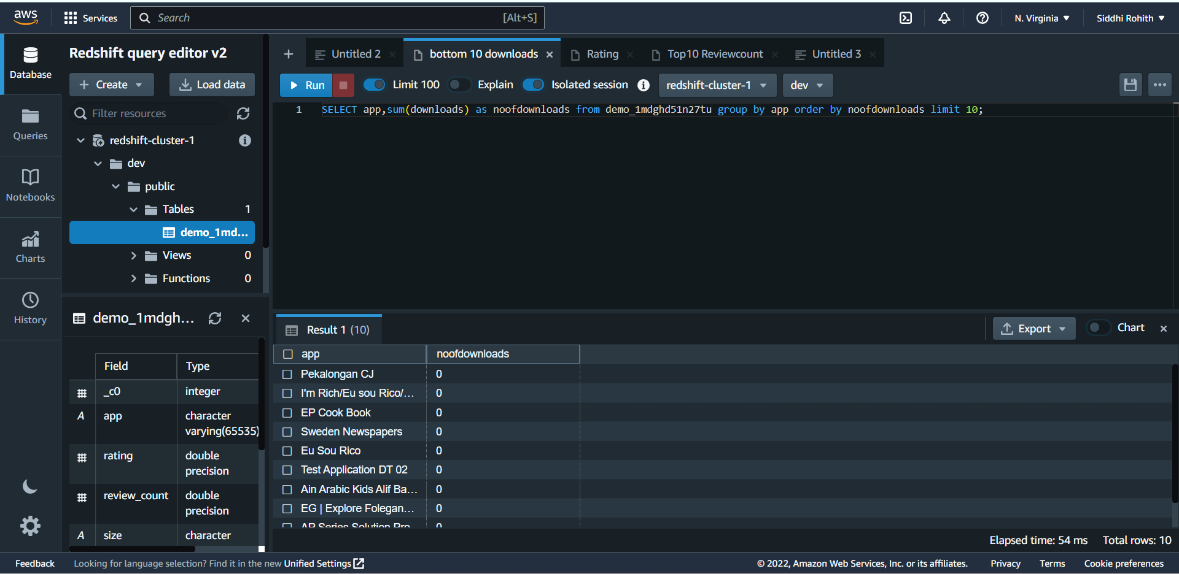
QUERY ANALYSIS:
CASE STUDY 2: BOTTOM10 DOWNLOADED APPS

Slide 15
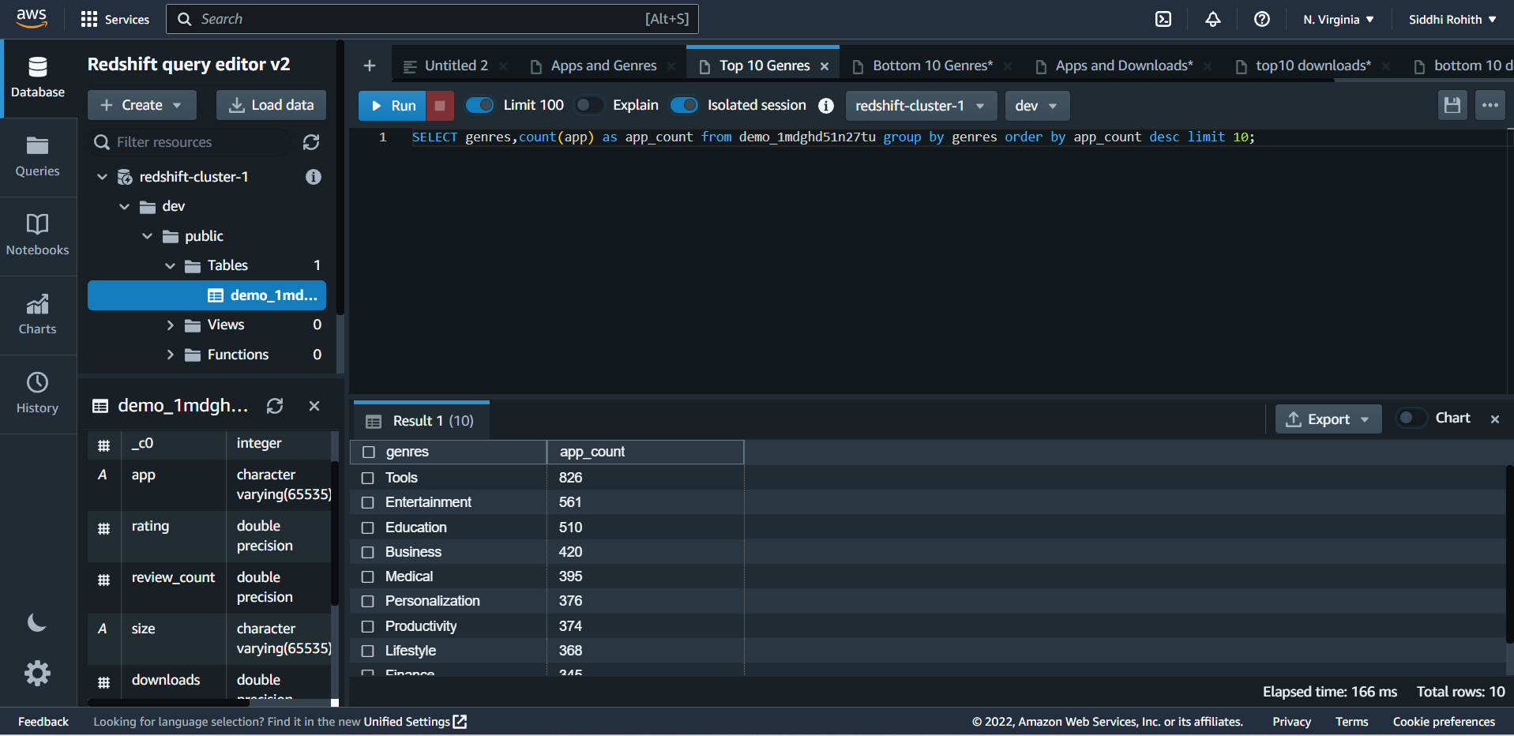
QUERY ANALYSIS:
CASE STUDY 3: TOP10 GENRES APPS

Slide 16
QUERY ANALYSIS:
CASE STUDY 4: TOP10 GENRES

Slide 17
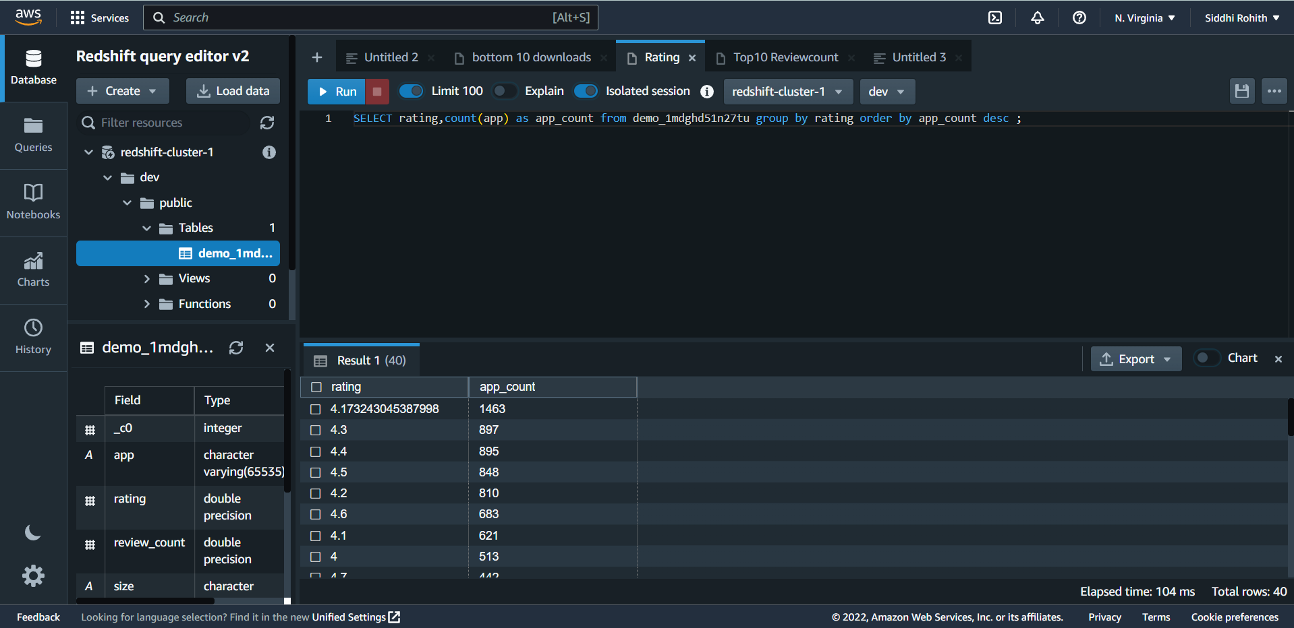
QUERY ANALYSIS:
CASE STUDY 5:RATING

Slide 18
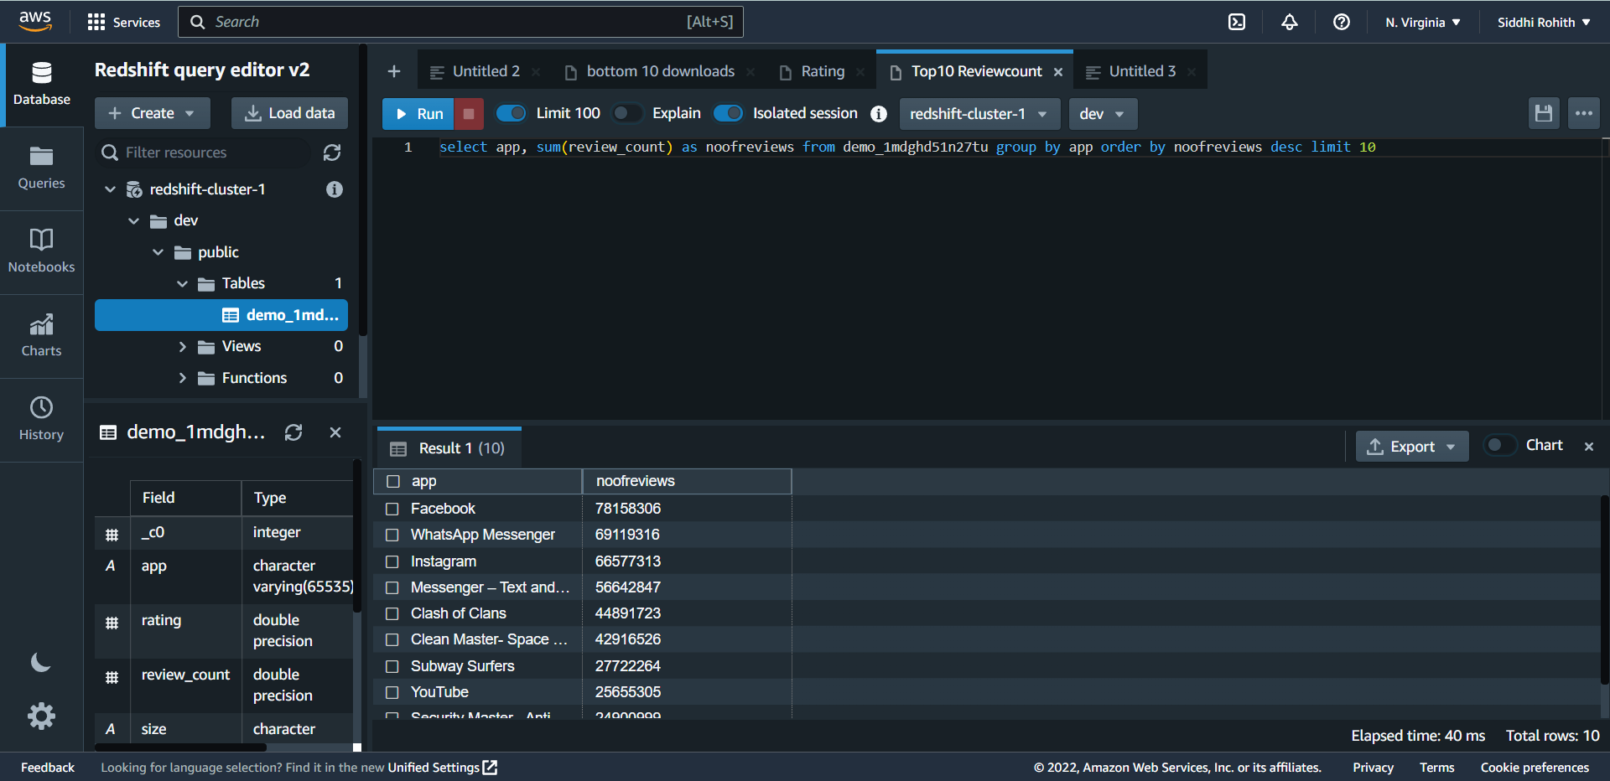
QUERY ANALYSIS:
CASE STUDY 6: TOP 10 REVIEWED APPS

Slide 19
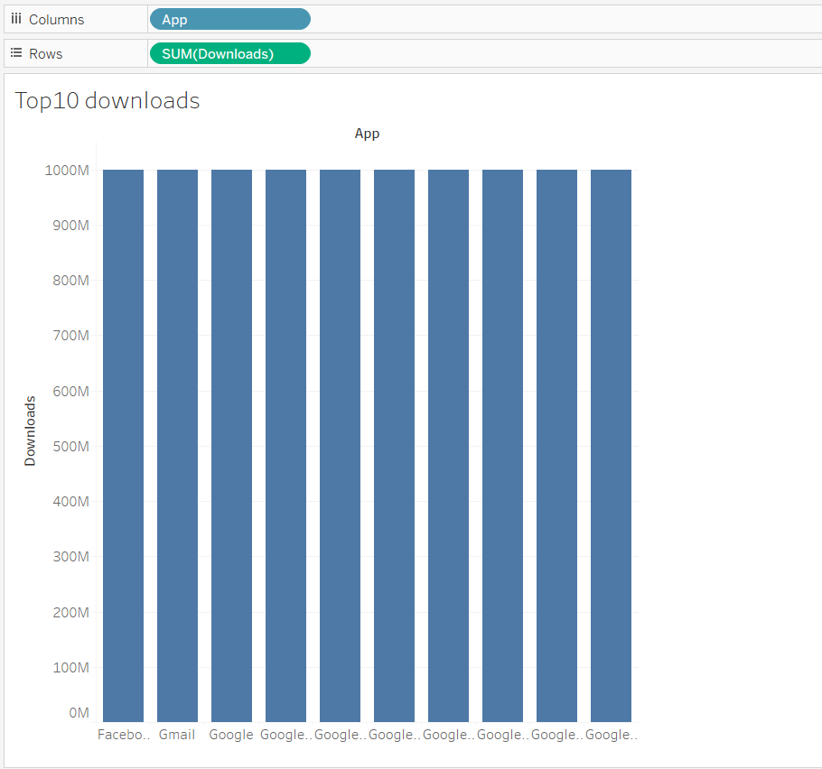
DATA VISUALIZATION ANALYSIS:
CASE STUDY 1: TOP10 DOWNLOADED APPS

Slide 20
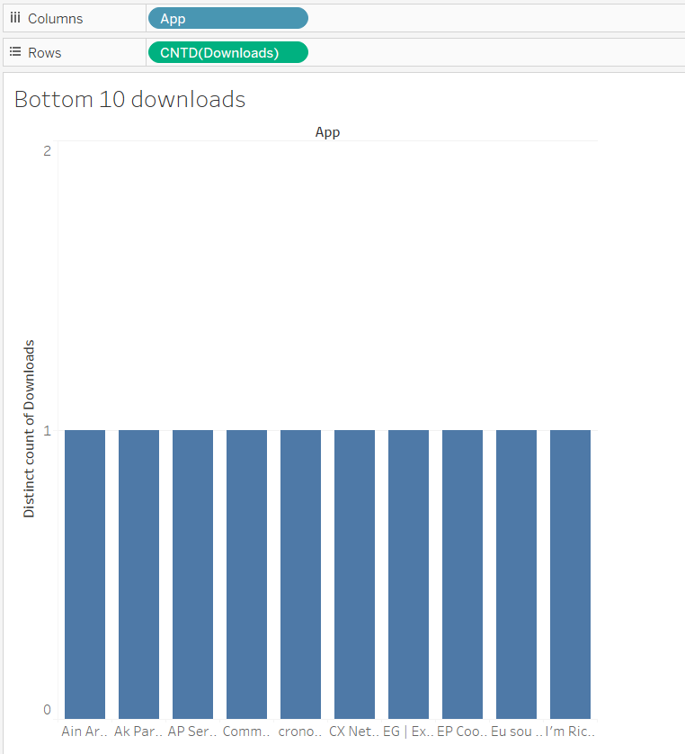
DATA VISUALIZATION ANALYSIS:
CASE STUDY 2: BOTTOM10 DOWNLOADED APPS

Slide 21
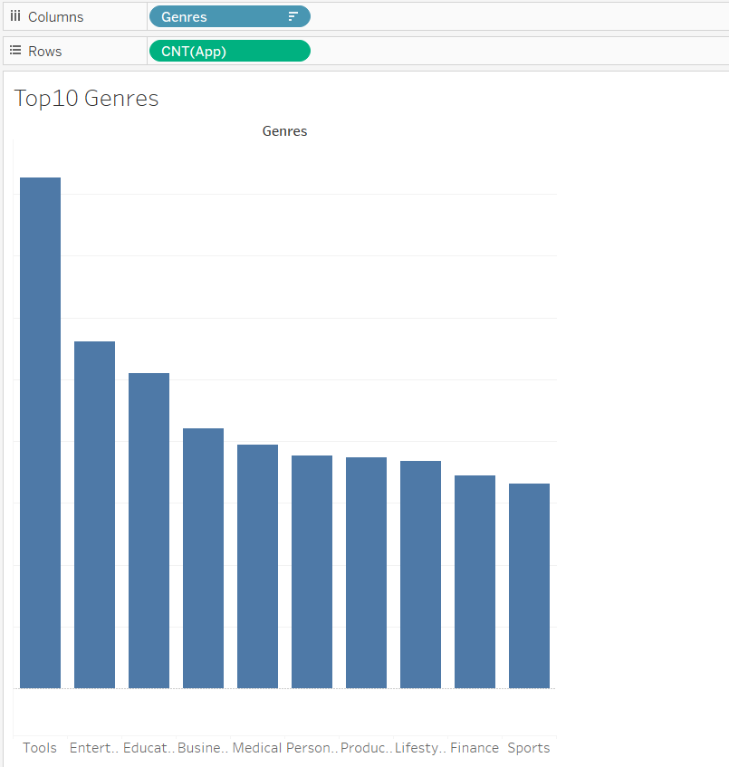
DATA VISUALIZATION ANALYSIS:
CASE STUDY 3: TOP10 GENRES APPS

Slide 22
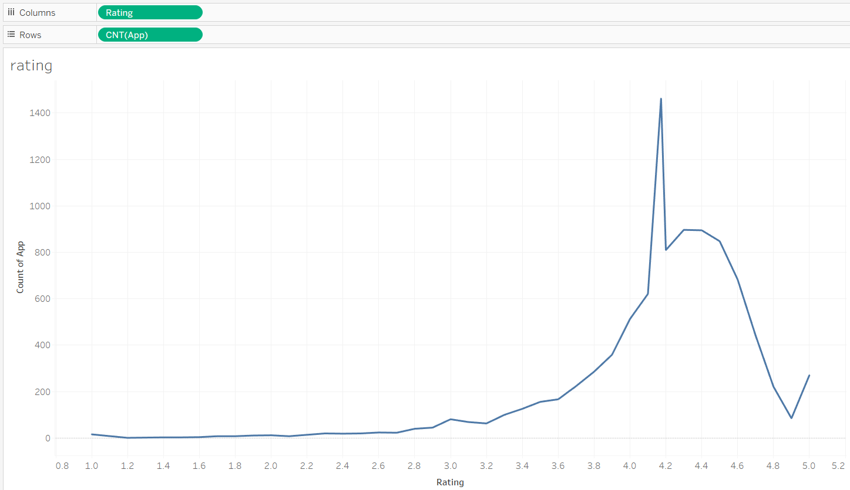
DATA VISUALIZATION ANALYSIS:
CASE STUDY 4: APPS RATING RANGE

Slide 23
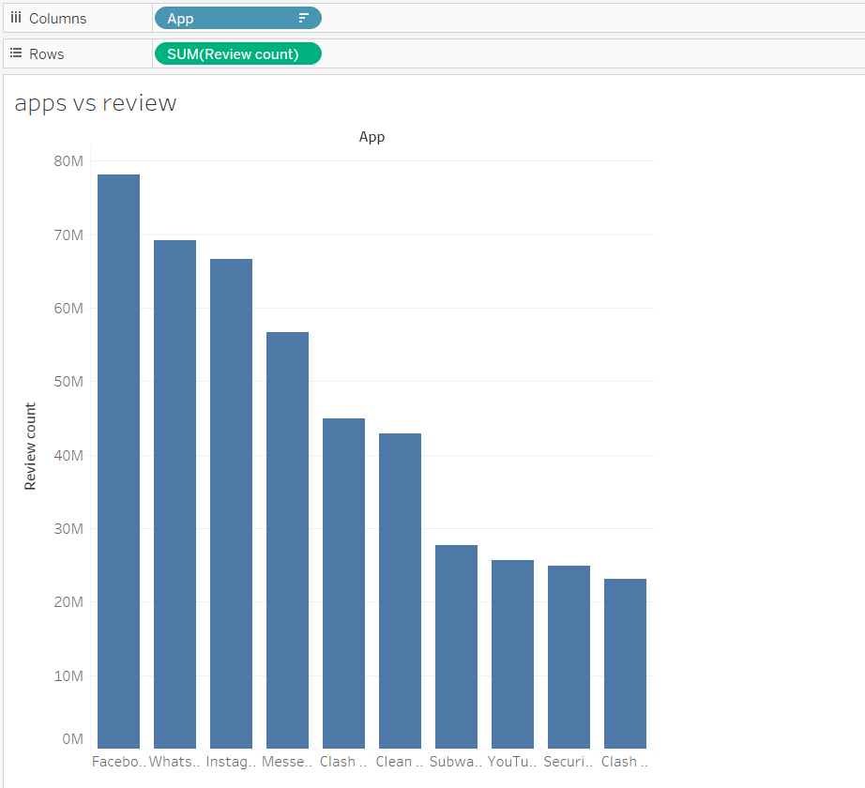
DATA VISUALIZATION ANALYSIS:
CASE STUDY 5: TOP10 REVIEWED APPS

Slide 24
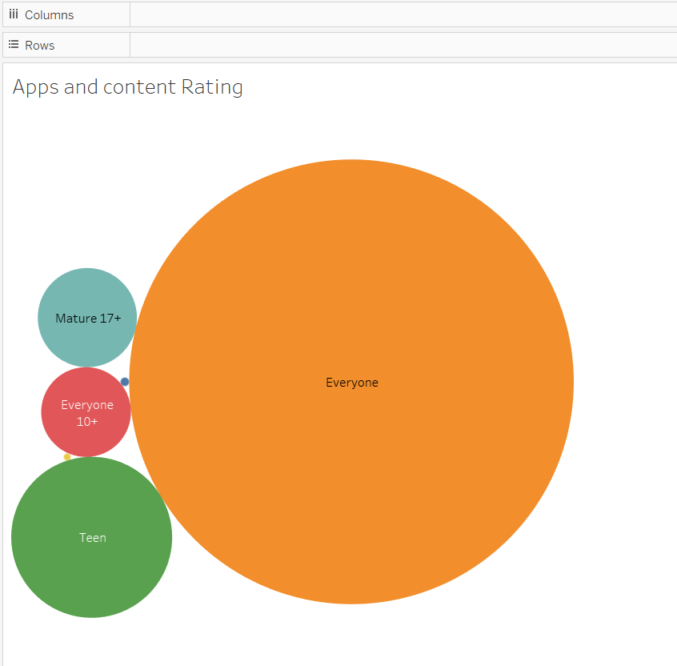
DATA VISUALIZATION ANALYSIS:
CASE STUDY 6: APPS AND THEIR CONTENT RATING

Slide 25
CONCLUSION:
From the Analysis and Visualization, I noticed below points:
Most downloaded App if FACEBOOK.
TOOLS genre consist of most of the Apps.
Most no. of Apps have the RATING of 4.173.
Most no. of Apps have the REVIEW COUNT of 5 MILLION.
Most Reviewed App is FACEBOOK.
Most no. of Apps fall into EVERYONE Content Rating

Slide 26




Thank you

